Slide 1
3D Genome
Dr. Zheng Wang
Assistant professor
Department of computer science
University of Miami

Slide 2
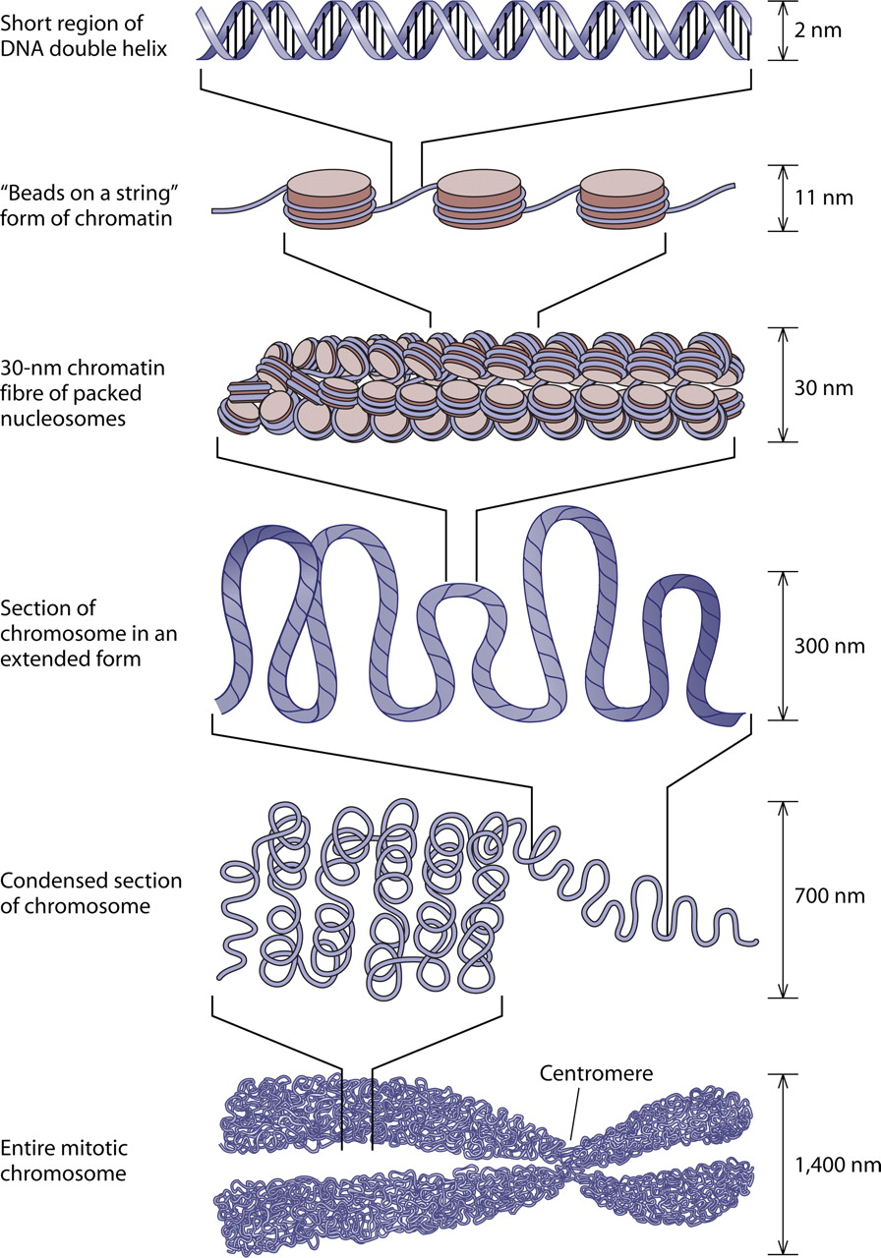
1970s: Laser-UV-microirradiation
1980s: situ hybridization
2002: 3C
(single vs. selected)
2006: 4C
(one vs. all)
2006: 5C
(many vs. many)
2009: Hi-C
(all vs. all)
Nucleosome Positioning in Saccharomyces cerevisiae, http://mmbr.asm.org/content/75/2/301/F3.expansion.html

Slide 3
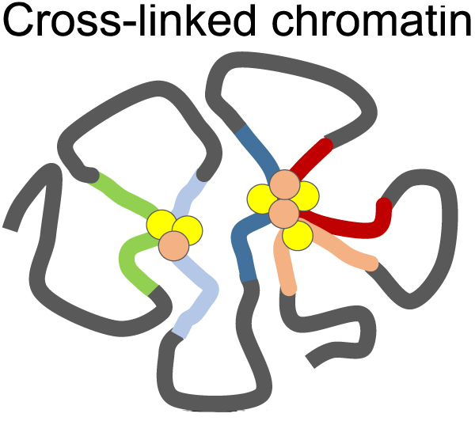
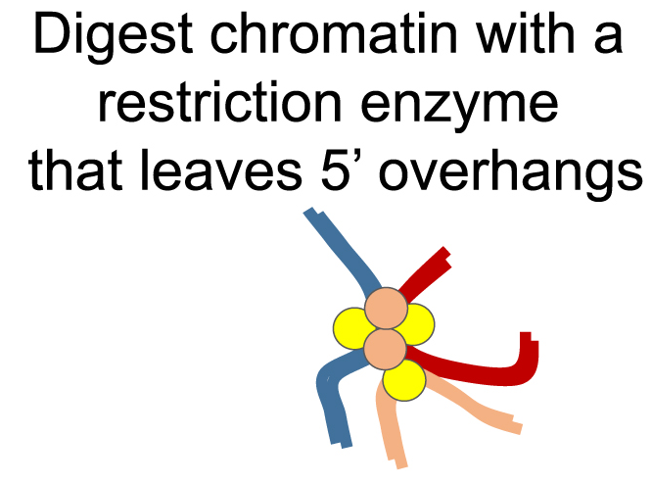
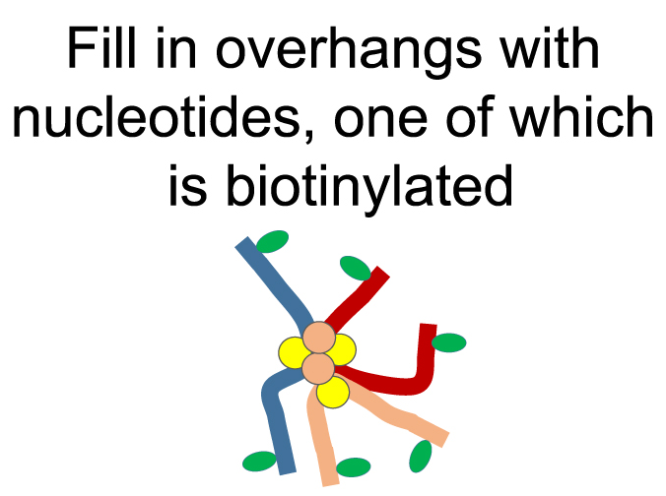
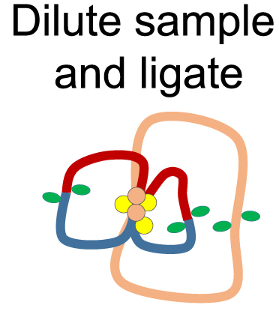
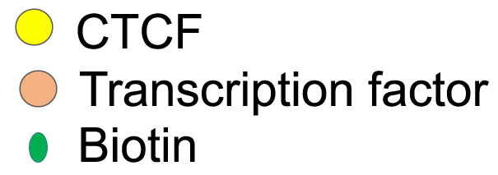

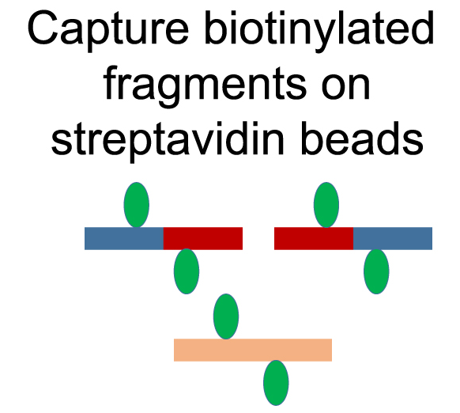
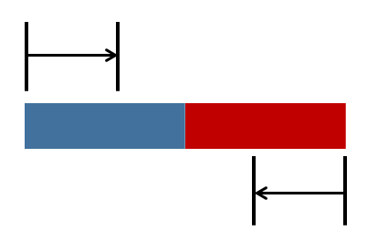
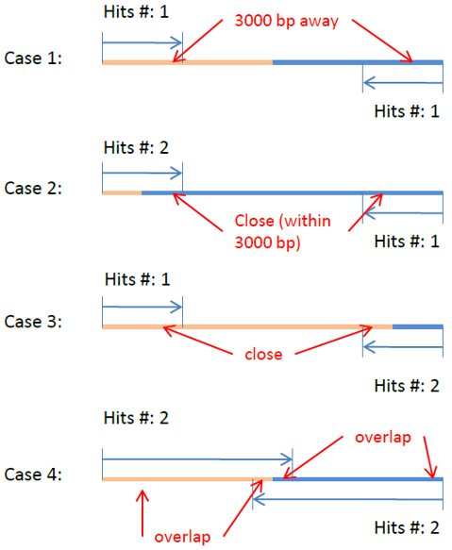
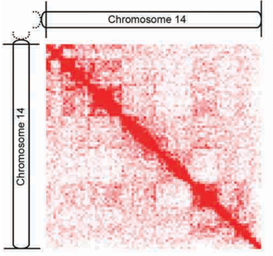
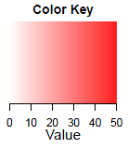
Mapped to reference genome
Chr.1
SRR027956.1, end 1
Chr.2
SRR027956.1, end 1
…
SRR027956.2, end 2
Chr.X
Quality check
Chr.Y
SRR027956.2, end 2
Hi-C contact complex library
Hi-C heatmap
(raw contact)
SRR027957.4113376|13 68376499 13 69322154|case 1
SRR027957.1112555|20 51083756 10 109271244|case 1
SRR027957.1471787|1 98444295 15 93541851|case 1
SRR027957.6064559|18 56232274 3 3357296|case 1
SRR027957.6034375|10 20738169 10 20990909|case 1
SRR027957.369478|21 40107802 21 37133986|case 1
SRR027957.1235641|17 14932245 X 143880940|case 1
SRR027957.6263830|15 52410607 15 45006111|case 1
SRR027957.365953|17 15854063 2 120423863|case 1
SRR027957.4166206|8 60204493 4 173137398|case 1
SRR027957.5574462|3 191758036 3 174505224|case 1
SRR027957.595946|5 13433817 12 38408499|case 1
SRR027957.4964593|14 46478556 14 46672038|case 1
…
1
Human Chr.14
106,368,585
107*107 matrix
395 million to 1.1 billion contacts
Resolution: 1M base pairs

Slide 4
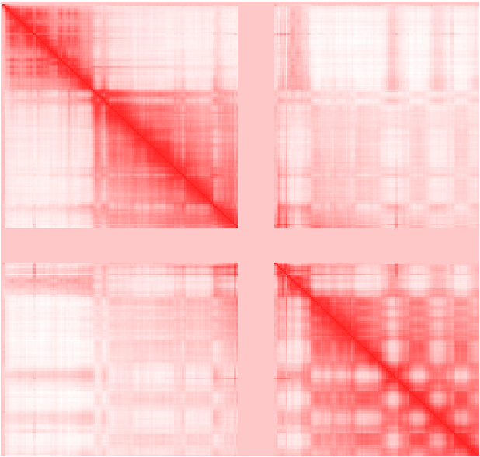
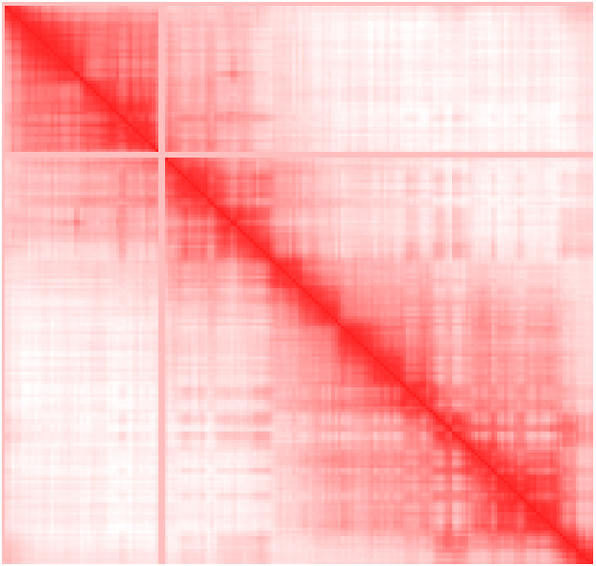
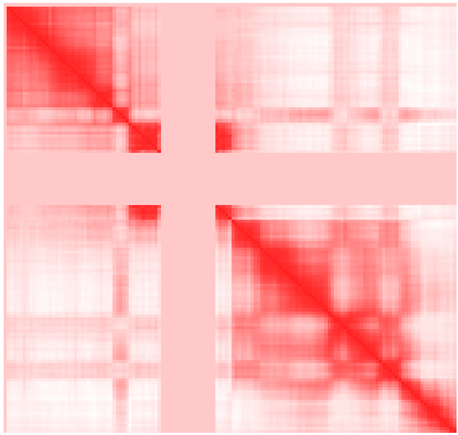
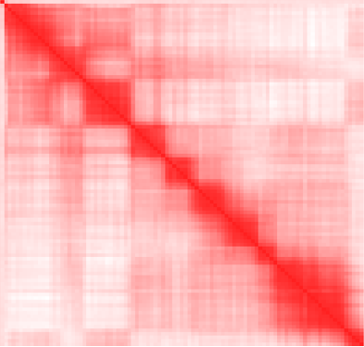
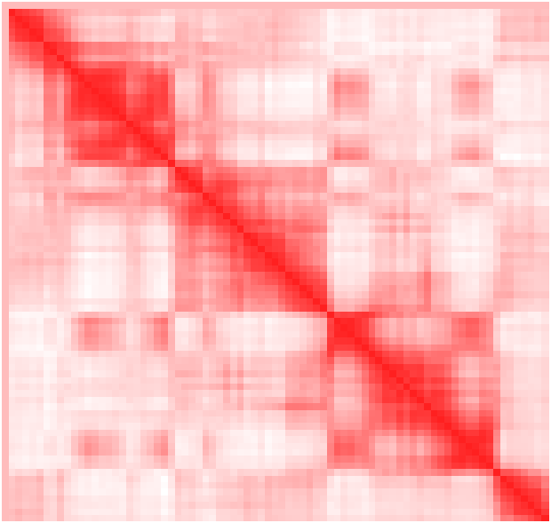
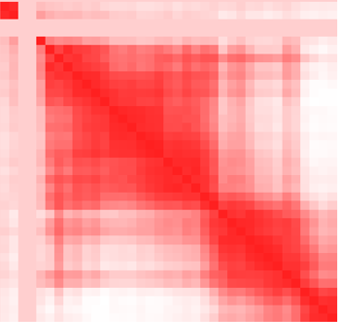
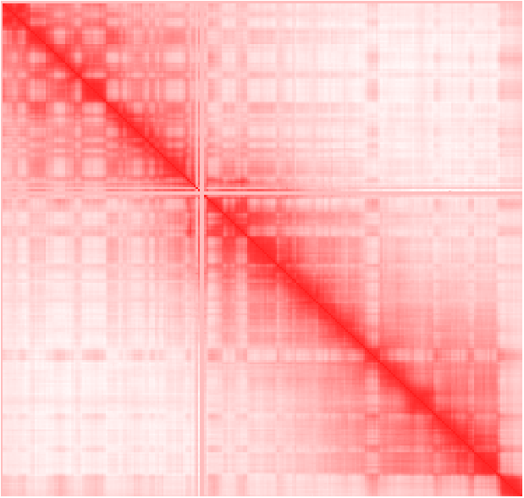
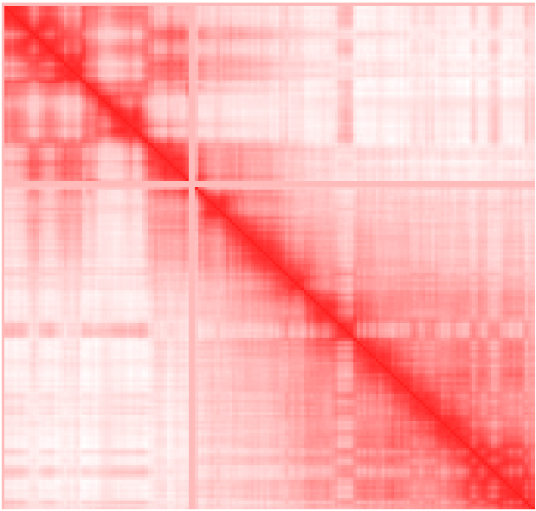
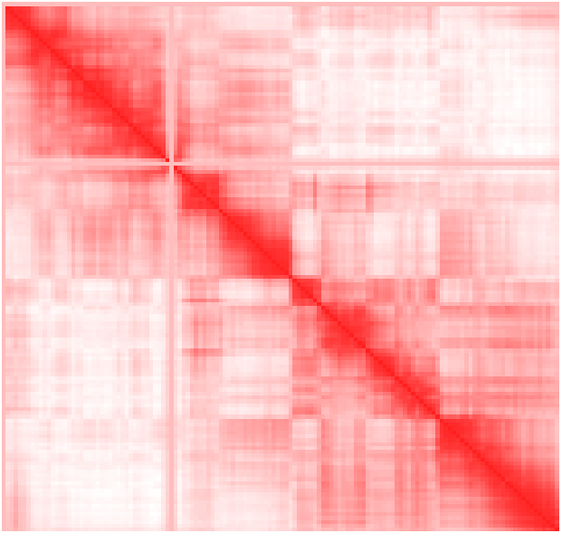
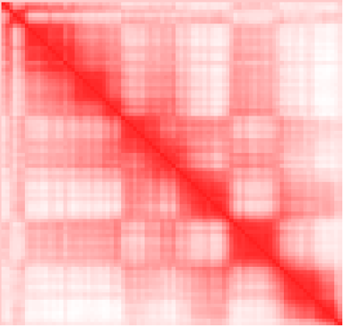
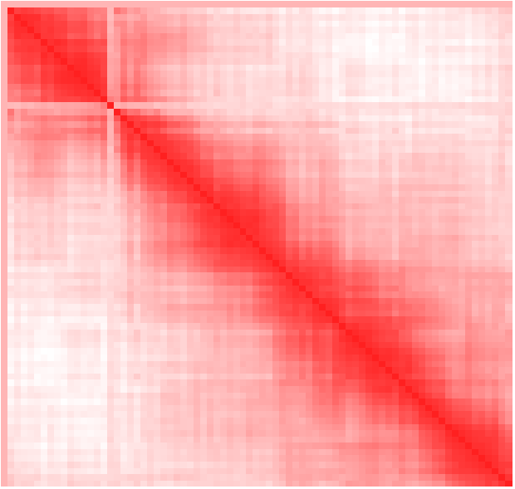
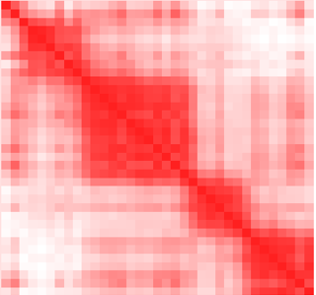
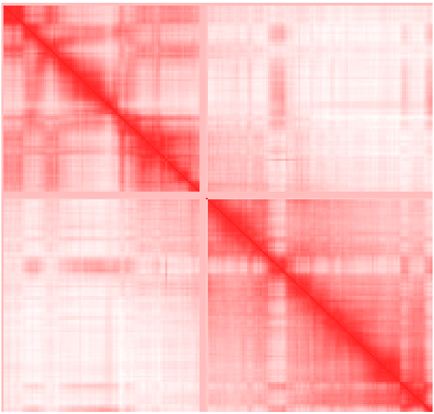
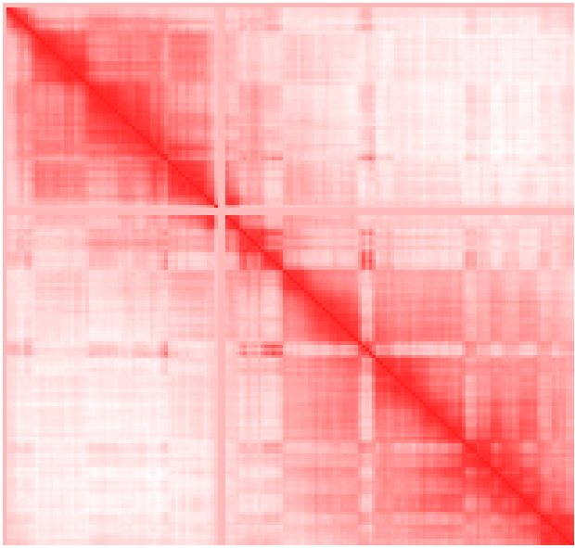
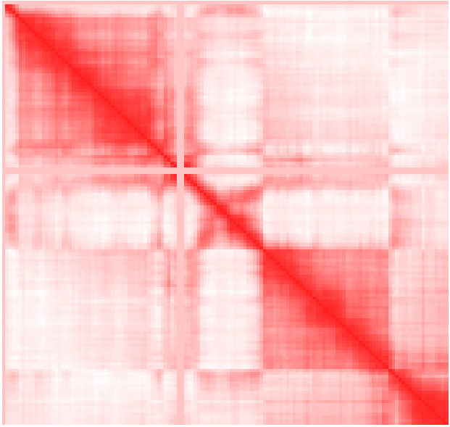
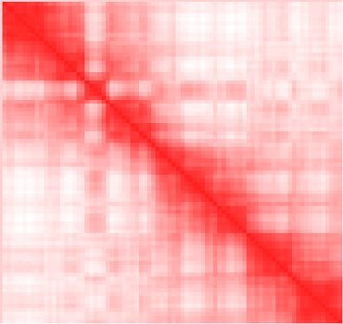
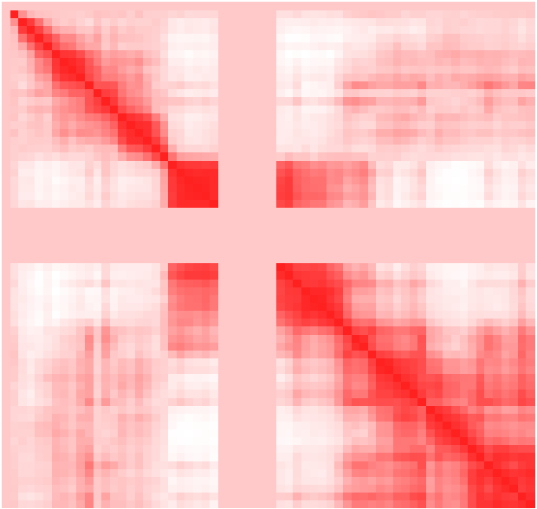
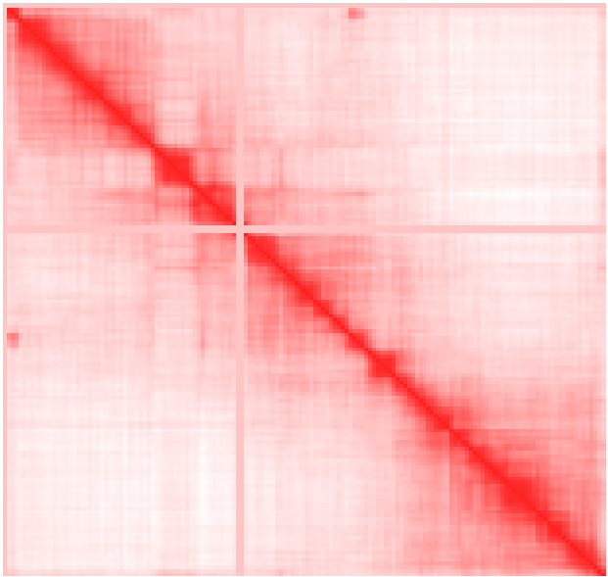
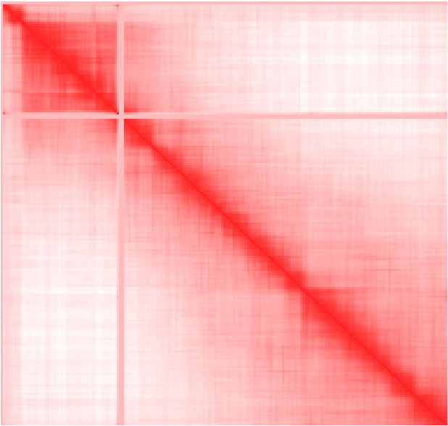
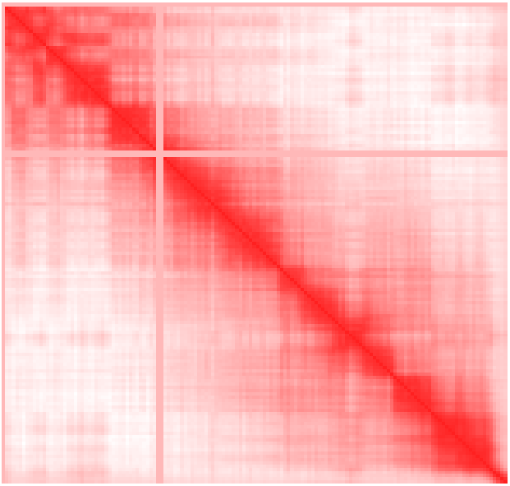
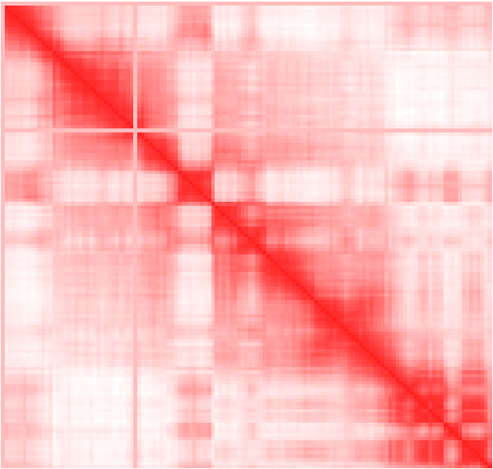
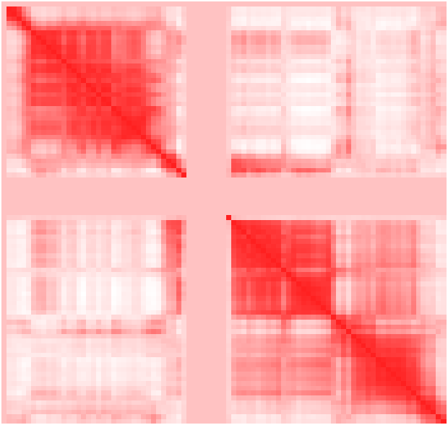
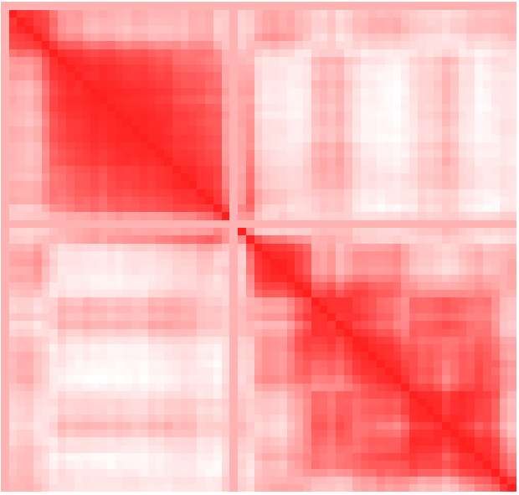
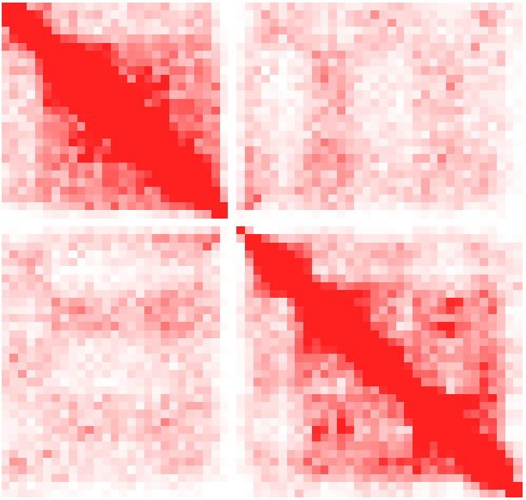
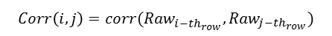
Correlation contact heatmaps of normal human B cells (GM06690), resolution 1M base pairs
chr. 1
chr. 5
chr. 9
chr. 13
chr. 17
chr. 21
chr. 2
chr. 6
chr. 10
chr. 14
chr. 18
chr. 22
chr. 3
chr. 7
chr. 11
chr. 15
chr. 19
chr. X
chr. 4
chr. 8
chr. 12
chr. 16
chr. 20 correlation
chr. 20 raw contact
(i, j)
i-th
j-th
$$Corr\left(i, j\right)=corr({Raw}_{i−th_{row}}^{},{Raw}_{j−th_{row}})$$

Slide 5
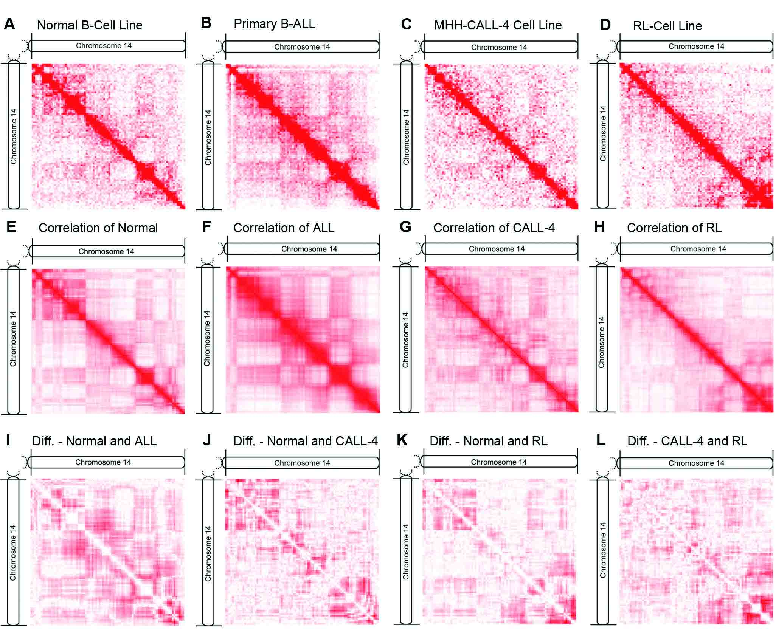
Normal (GM12878) vs. malignant human B-cell on chromosome 14
ALL: primary human acute lymphoblastic leukemia B-cell
CALL-4: acute lymphoblastic leukemia (pre B-ALL)
RL: lymphoma cell line

Slide 6
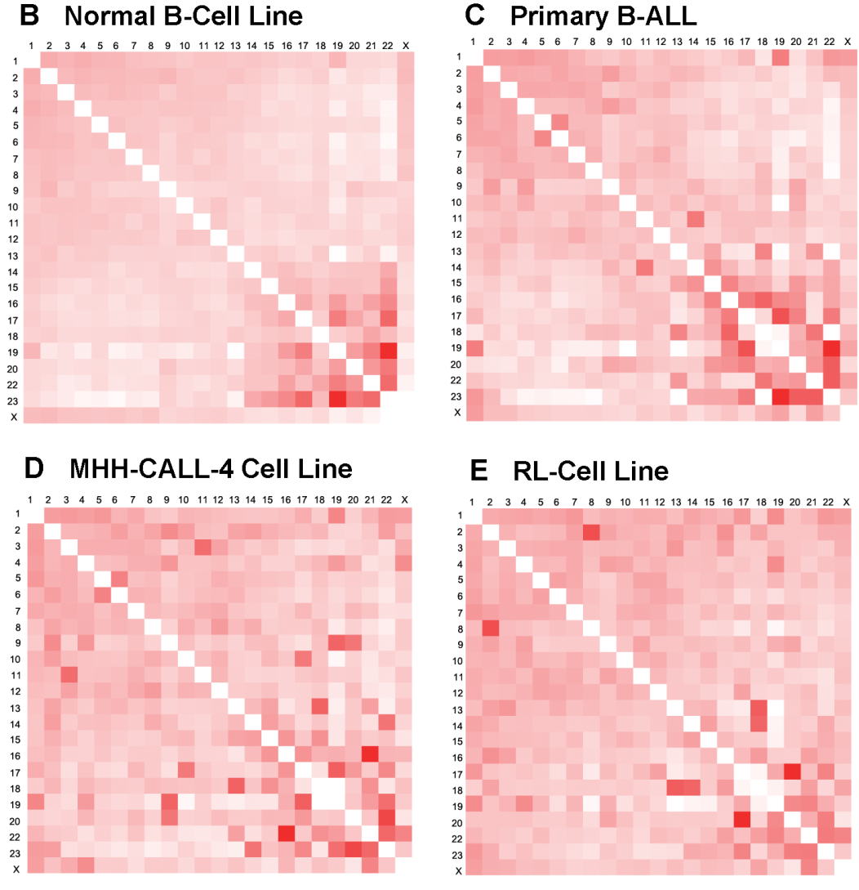
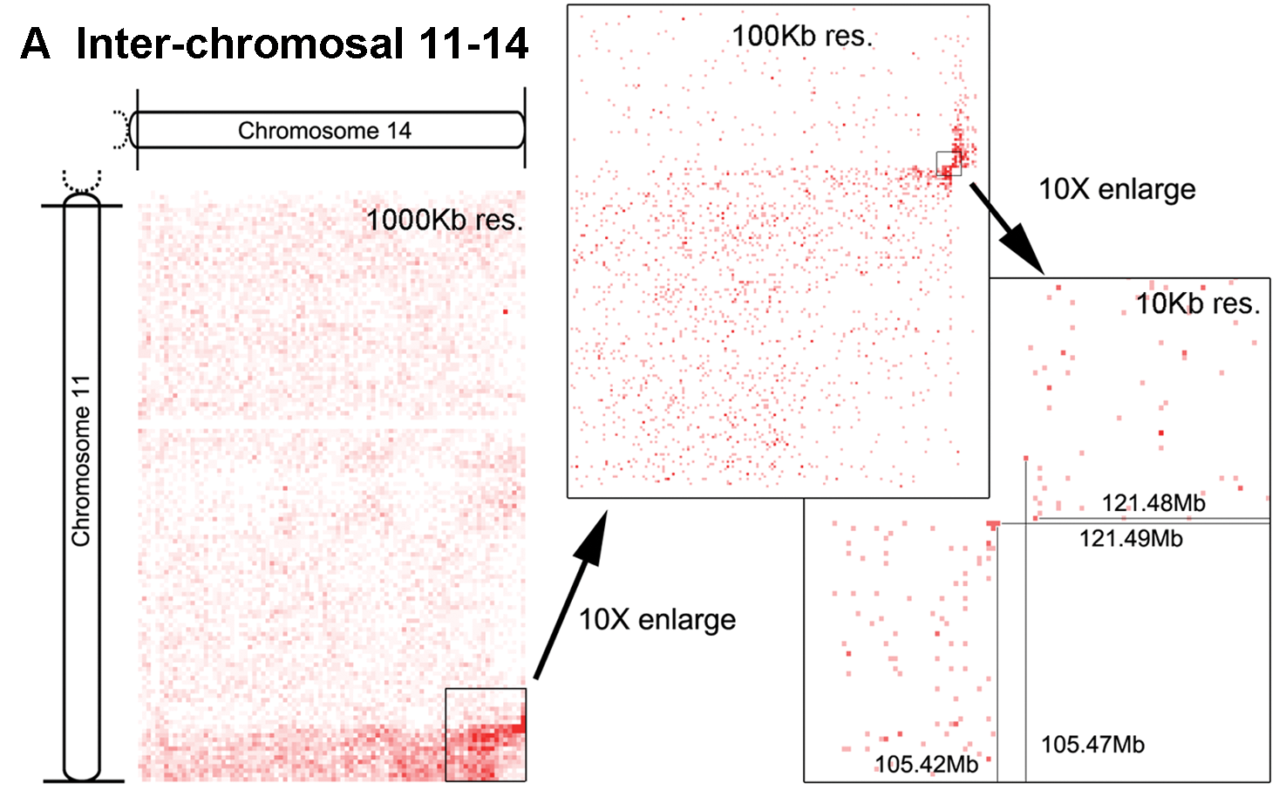
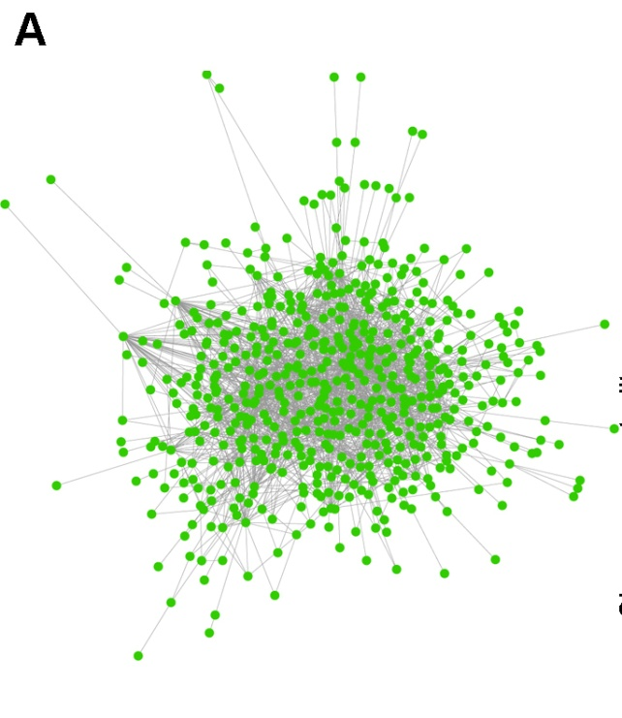
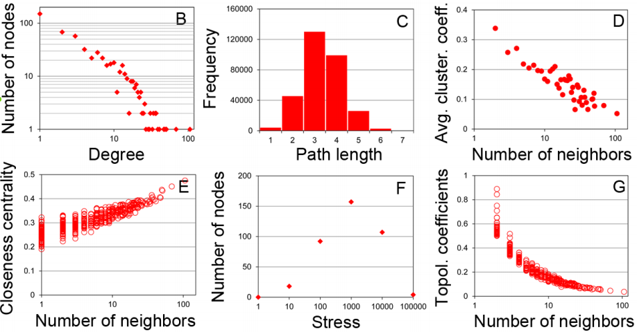
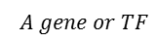
Observed/expected inter-chromosomal
contacts
Chromosomal translocation - ALL
R: fractions of inter-chromosomal reads
N: total number of inter-chromosomal contacts
$$A gene or TF$$
Spatial Gene-TF Interaction Networks (chr.14)
IMR-90: normal human lung fibroblast cells
HMEC: normal human epithelial cells
NHEK: normal human epidermal cells
K562: immortalised human myelogenous leukemia
HUVEC: human umbilical vein endothelial cells
HeLa: human cervical cancer
KBM-7: human chronic myelogenous leukemia (CML)
Mouse ES: embryonic stem cells
Human ES: embryonic stem cells
GM12878: human peripheral vein B cells
GM06690: human EBV-transformed lymphoblastoid cell line

Slide 7
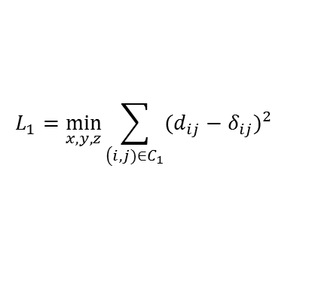
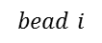
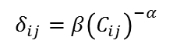
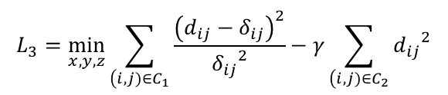
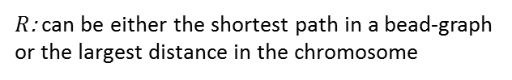
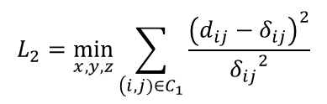
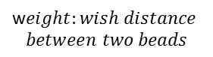
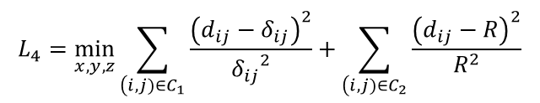



500K base pairs
3D Structure Re-construction – New Method 1 (resolution 1M -> 500K)
i
$$δ_{ij}=β{\left(C_{ij}\right)}^{−α}$$
$δ_{ij}$: the wish distance between beads i and j
$C_{ij}$: number of normalized Hi-C contacts between beads i and j
$α=\frac{1}{3}, β=1$
j
Multidimensional scaling (MDS)
$$d_{i,j}=\sqrt{\sum_{i=1,j=1}^{n}{{(x_{1}^{i}−x_{1}^{j})}^{2}+{(x_{2}^{i}−x_{2}^{j})}^{2}+{(x_{3}^{i}−x_{3}^{j})}^{2}}}$$
$$L_{1}=\min_{x,y,z}{\sum_{\left(i, j)∈C_{1}\right.}{{(d_{ij}−δ_{ij})}^{2}}}$$
$$L_{2}=\min_{x,y,z}{\sum_{\left(i, j)∈C_{1}\right.}{\frac{{\left(d_{ij}−δ_{ij}\right)}^{2}}{{δ_{ij}}^{2}}}}$$
$$C_{1}=\left\{\left(i, j\right) | c_{ij}≠0\right\} \text{and} C_{2}=\left\{\left(i, j\right) | c_{ij}=0\right\}$$
w$eight:wish distance$
$$between two beads$$
$$L_{3}=\min_{x,y,z}{\sum_{\left(i, j)∈C_{1}\right.}{\frac{{\left(d_{ij}−δ_{ij}\right)}^{2}}{{δ_{ij}}^{2}}−γ\sum_{\left(i, j)∈C_{2}\right.}{{d_{ij}}^{2}}}}$$
$$bead i$$
$$L_{4}=\min_{x,y,z}{\sum_{\left(i, j)∈C_{1}\right.}{\frac{{\left(d_{ij}−δ_{ij}\right)}^{2}}{{δ_{ij}}^{2}}+\sum_{\left(i, j)∈C_{2}\right.}{\frac{{\left(d_{ij}−R\right)}^{2}}{R^{2}}}}}$$
$$bead j$$
$R$: can be either the shortest path in a bead-graph
or the largest distance in the chromosome
This network is only for illustration

Slide 8





Three-dimensional structure of chr. X of male mouse embryonic stem cells. Resolution: 500K base pairs.
The RAP data showing Xist localization along entire X chromosome. The two shaded areas were enlarged in the right.
Left: active (Xa) and inactive (Xi) X chromosome from FISH
The Hi-C topological domains integrated with Xist localization, CTCF binding, histone modification, and transcribed genes for ChrX 70Mb - 90Mb.
The Hi-C topological domains integrated with Xist localizations (RAP), CTCF binding, histone modification, and transcribed genes for chrX 95Mb - 105Mb.
Above image is from https://en.wikipedia.org/wiki/X-inactivation

Slide 9

Three-dimensional structure of chr. X of male mouse embryonic stem cells. Resolution: 500K base pairs.
Model the dynamics of the shrinking process of the 3D structure or the spatial proximity networks (can be a NIH R21 or part of a R01 proposal)

Slide 10









3D Structure Re-construction – New Method 2 (resolution 1M -> 500K -> 40K)
$$δ_{ij}=β{\left(C_{ij}\right)}^{−α}$$
$δ_{ij}$: the wish Euclidean distance between beads i and j
$C_{ij}$: number of normalized Hi-C contacts between beads i and j
$α=\frac{1}{3}, β=1$
$$δ_{ij}=β{\left(C_{ij}\right)}^{−α_{ij}}$$
$α_{ij}$: different pair of beads has different $α$
MCMC simulation

Slide 11










$$δ_{ij}=β{\left(C_{ij}\right)}^{−α_{ij}}$$
If Hi-C contact >= 1,
there is an edge
$$α_{ij}={{(w}_{i}α_{i}+w_{j}α_{j})}/{(w_{i}}+w_{j})$$
bead i
$α_{i}$: the “clustering strength” of bead i
$w_{i}$: the sum of Hi-C contacts in the ith row
bead j
$$\underset{}{L=min}{\sum_{i=1}^{n}{λ_{1}{\left(α_{i}−λ_{2}{CC}_{i}\right)}^{2}+\sum_{\left(i,j,k)∈PT\right.}{λ_{3}\left\{{\left(α_{i}−α_{j}\right)}^{2}+{\left(α_{i}−α_{k}\right)}^{2}+{\left(α_{j}−α_{k}\right)}^{2}\right\}}}}$$
i-th
k-th
j-th
subject to the following two constrains:
constrain 1: 0$≤α_{i}≤1 i∈\left[1⋯n\right]$
This network is only for illustration. The
real Hi-C complex network is much bigger
and well-connected
$$constrain 2: \left\{\begin{aligned}&d_{ij}+d_{ik}≥d_{jk} \\ &d_{ij}+d_{jk}≥d_{ik} \\ &d_{ik}+d_{jk}≥d_{ij}\end{aligned} | \begin{aligned}&if \left|i−j\right|=1, k≠i, k≠j, \\ &c_{ij}>0, c_{ik}>0, c_{jk}>0\end{aligned}\right\}$$
(triangle inequality)
$${CC}_{i}={2\left|\left\{e_{jk}: c_{ij}>0, c_{ik}>0, c_{jk}>0\right\}\right|}/{\left(n_{i}(n_{i}−1)\right)}$$
(clustering coefficient)
$$PT=\{(i, j, k)|P_{ij}>P_{C},P_{ik}>P_{C},P_{jk}>P_{C}\}$$
$P_{C}=0.9$: the cut-off Pearson’s correlation
$λ_{1},λ_{2}$, $λ_{3}$: three constants tuned based on FISH experiment

Slide 12

Figure (A) the 3D structure of chromosome X with Xist transcript enrichment mapped (resolution 40K base pair); (B) the 3D structure of chromosome X (without edges) consisting of two compartments; (C) and (D) the interior structures of compartment 1 and compartment 2 respectively (videos can be found at https://www.youtube.com/playlist?list=PLjYXiaTU5InQDq5wzeiVMeZK9WlduHXvu).

Slide 13

Minimum dominating sets of proteins (MDSets) were enriched with essential, cancer-related, and virus-targeted genes?
Networks of networks?
Model the dynamics of the whole genome?
Collaborate

Slide 14



Topological domains in Mammalia genomes - structural and functional unit of the genome
On average, ~1M base pairs long
Reads per kilobase per million reads
A novel structural measurement (based on radius-of-gyration) also considering the 3D location of histone modifications and other genomics features
$$R_{g}^{2}=\sum{{{\left.m_{i}(r_{i}−R_{C}\right)}^{2}}/M}$$
where $M$ is the sum of masses of all the beads in the topological domain, that is, sum of all the $m_{i}$ (i = 1, 2, 3, …, n; n is the number of beads in the domain); $R_{c}$ is the center of mass
$$m_{i}= {m_{i}^{nt}(w}_{i}^{CTCF}+w_{i}^{H3K27ac}+w_{i}^{H3K27me3}{+ w}_{i}^{H3K36me3}+w_{i}^{H3K4me1}+w_{i}^{H3K4me3}{+ w}_{i}^{transcribed_genes})/C$$
where $C$ is the number of experiments integrated, $m_{i}^{nt}$is the mass of considering nucleotides only and can be set to 0.4 for 40K resolution
$w_{i}^{CTCF}$is the weight for CTCF binding signals that is calculated as $w_{i}^{CTCF}=S_{i−avg}^{CTCF}/S_{avg−whole−genome}^{CTCF}$

Slide 15


Pearson’s correlations between the four measures: HD ratio, PCA index, folding degree, and radius of gyration and some genomic features, including gene density, CTCF, RNA polII, H3K4me3, H3K9me3, H3K27me3, and H3K36me3, for 2,040domains
The Pearson’s correlations between structural signature measures (Radius of gyration, folding degree, PCA index, and HD ratio) and genomic features (gene density, CTCF, RNA polII, H3K4me3, H3K9me3, H3K27me3, and H3K36me3) using the 2,040 domains

Slide 16
Source Code
Example of next-generation sequencing data
Python scripts for generating 3D genome

Slide 17
Thank you!
Questions

